Slide 1



CASE STUDIES
NARRATED SLIDES
www.shared-interest.com

Slide 2
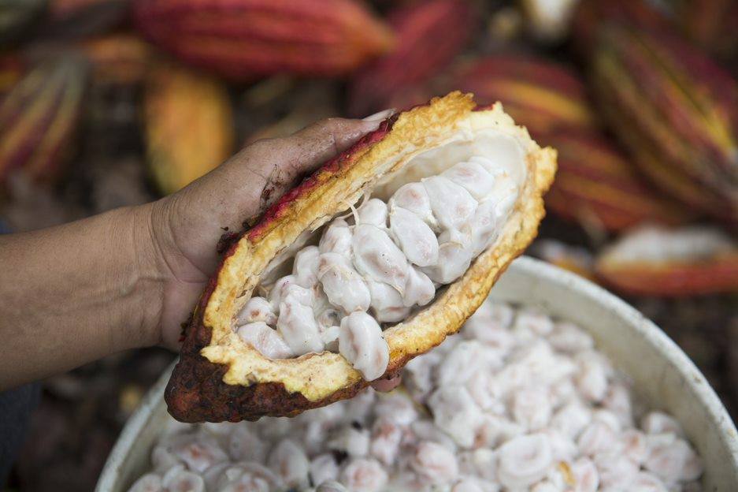
ALTO HUALLAGA
www.shared-interest.com
Notes:
A worker removes cacao beans from a pod at a farm in Peru. The beans are collected in buckets before they are placed in sacks and sent to a warehouse for processing.

Slide 3
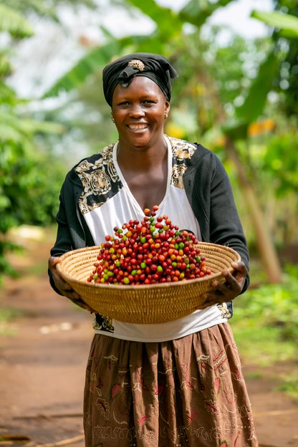
KIBINGE
www.shared-interest.com
Notes:
Aisha Najuma, a Kibinge coffee producer, holding freshly picked coffee berries on a farm in Uganda.

Slide 4
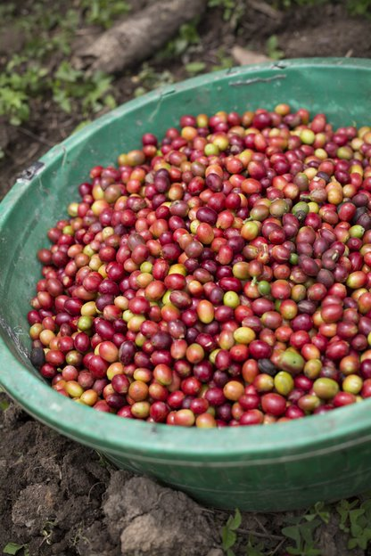
KIBINGE
www.shared-interest.com
Notes:
Freshly picked coffee berries on a farm in Uganda.

Slide 5
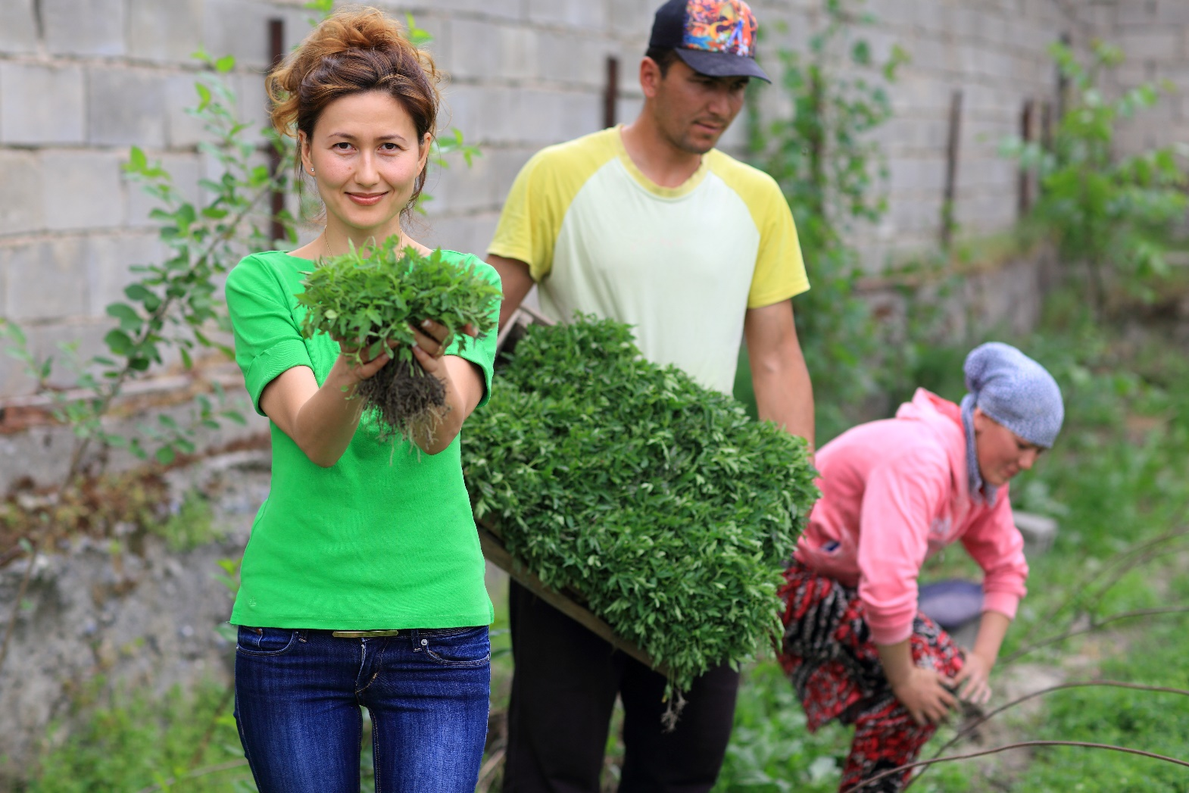
LEMBERONA
www.shared-interest.com
Notes:
Lemberona Co-founder Elmira Bertagnoli with Rustam Rahimov, president of smallholder producer organisation Torob Bobo.

Slide 6
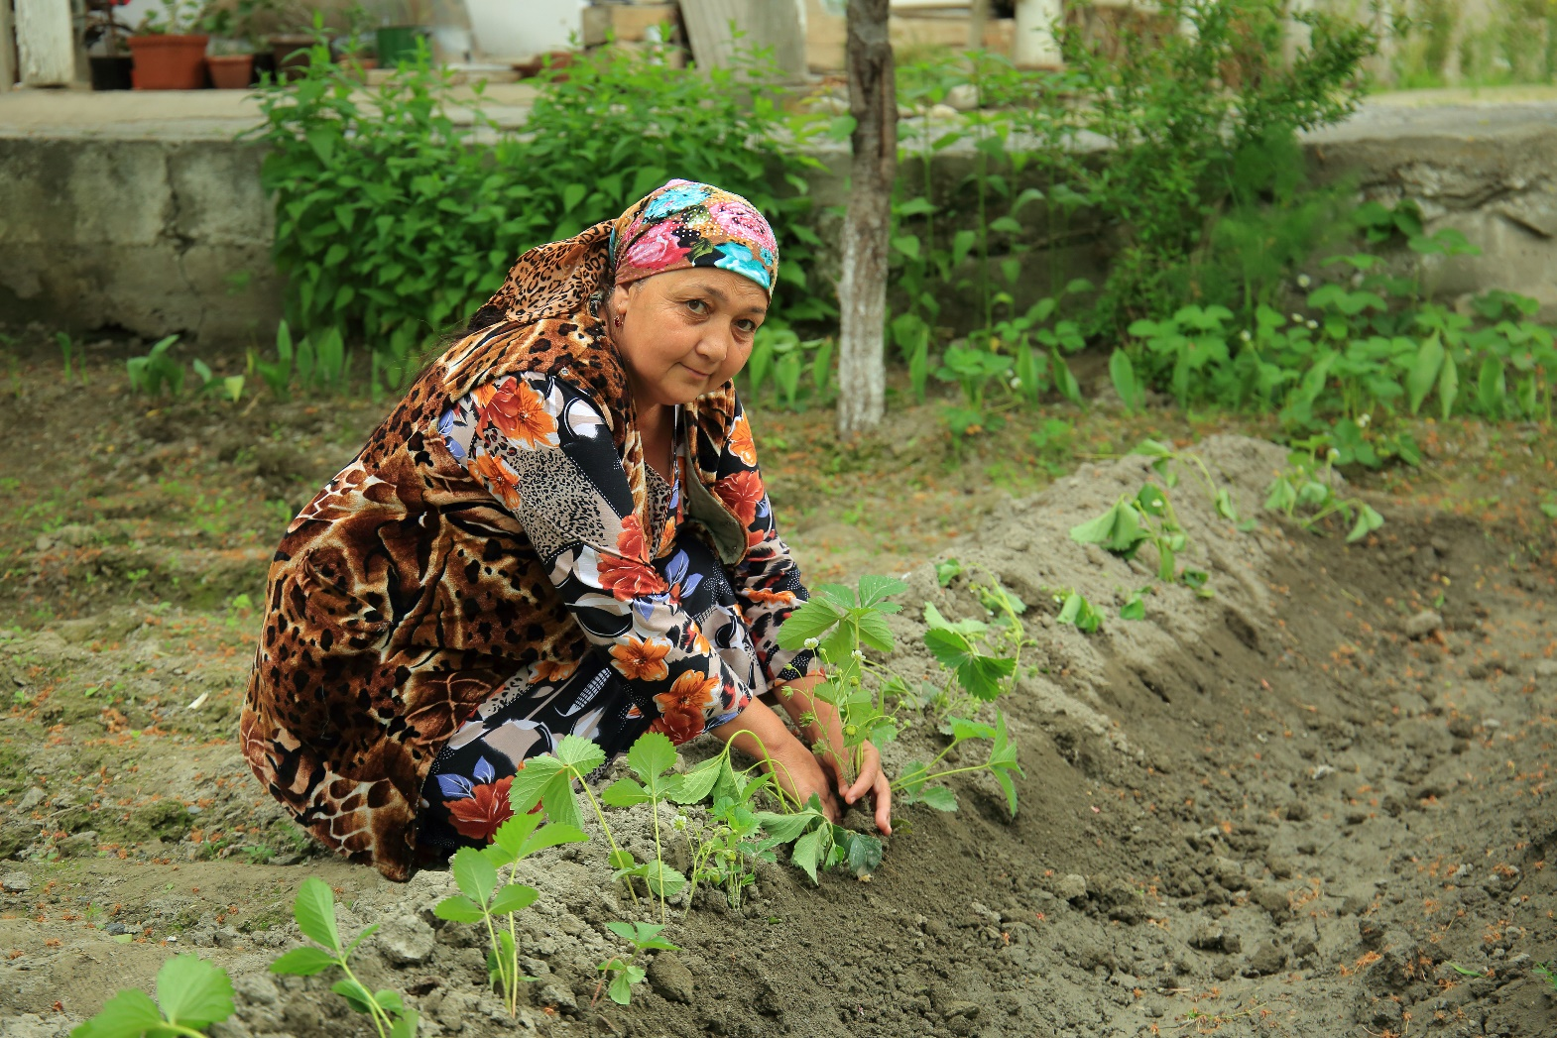
LEMBERONA
www.shared-interest.com
Notes:
Image Above: Turob Bobo member Nizomova Salima at a mixed plantation

Slide 7
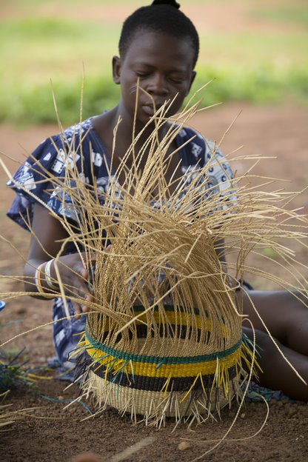
TRADE AID
www.shared-interest.com
Notes:
Amah Akologo, a member of Amongtaaba Basket Weavers Group (working with TradeAID), weaves baskets in Sumbrungu Zobiko Village, Bolgatanga District, Ghana.

Slide 8
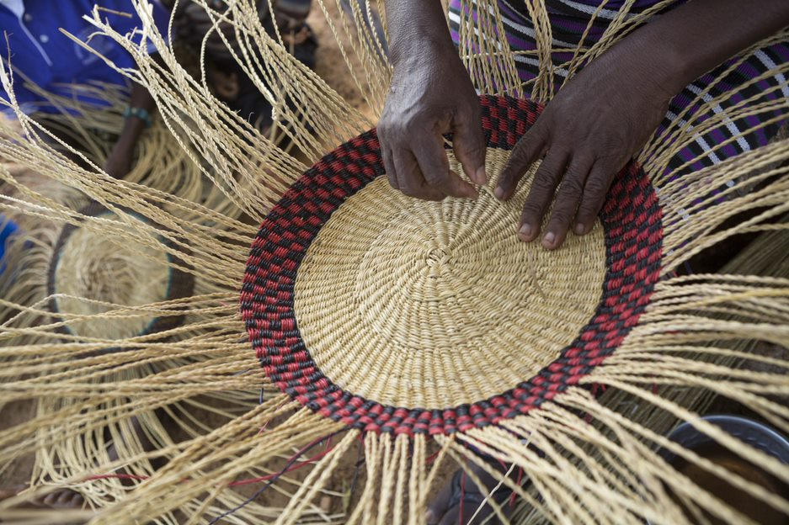
TRADE AID
www.shared-interest.com
Notes:
Ornate straw baskets are woven by the women of Asungtaaba Basket Weavers Group (working with TradeAID) in Ghana.

